Slide 1


Theory +Economic Survey Vol.2 + Vol.1 + Budget 2016
1.Banking Finance
6.HRD
2.Budget-Fiscal Policy
3.BoP
4.Sectors of Economy
5.Infra
V2C2-Pub.Fin; V1C3-JAM
V2C3-Monetary mgmt+FI
V2C4-External sector
V2C5-Price,Agri.; V2C6,7
V2C8-Paris Summit, Energy
V2C9-Social infra.
V1C4-Agri ; V1C9-Fertilizer
V1C5-mother-child
V1C6-bounties; V1C7-Fiscal Cap
V1C8-PTA
V1C2-Chakravy; V1C10-Labour
V1C11-Powering 1 India
B1. Financial Sector Reforms
B2. Fiscal Discipline
B3. Tax Reforms; B4. Ease of
B5. Agro: 2x farmer income
B6. Rural infra-employment
B7. Infrastructure
B8. Social Sector & healthcare
B9. Education, Skills, Jobs
V2C1- Chakravyuh challenge
V1C1- Twin Balancesheet
IYB:7-Commerce
Agri
Mfg
MicroEcon
GDP Inflation

Slide 2
UPSC’s CDS-II/2015
What is meant by ‘Public Good’?
A commodity produced by the Government
A commodity whose benefits are indivisibly spread among the entire community
A Government scheme that benefits the poor households
Any Commodity that is very popular among general public

Slide 3
UPSC’s CDS-2016/1
Kerosene is inferior good in India, what are its implications?
As household gets richer, it consumes less kerosene
Over the time, kerosene quality declines
Government needs to stop Kerosene subsidy
Answer choice: 1&2, 2&3….

Slide 4
UPSC’s APFC/EPFO-2016
Which of the following modes of transportation has the highest elasticity ?
Air
Rail
Road
Water

Slide 5
UPSC’s APFC/EPFO-2016
The demand for a “factor of production” is said to be derived demand because
It is a function of the profitability of an enterprise
It depends on the supply complementary factors
It stems from the demand for the final product
It arises out of means being scarce in relation to wants

Slide 6

Why Microeconomics this year?
Not much prelim-worthy maal in this year’s budget & survey
Microeconomics: little higher than NCERT but ~1:30 hrs @max
Banking, BoP, Budget, GDP-CPI-WPI etc theory already done last year
Useful in CDS, APFC, SSC anyways

Slide 7
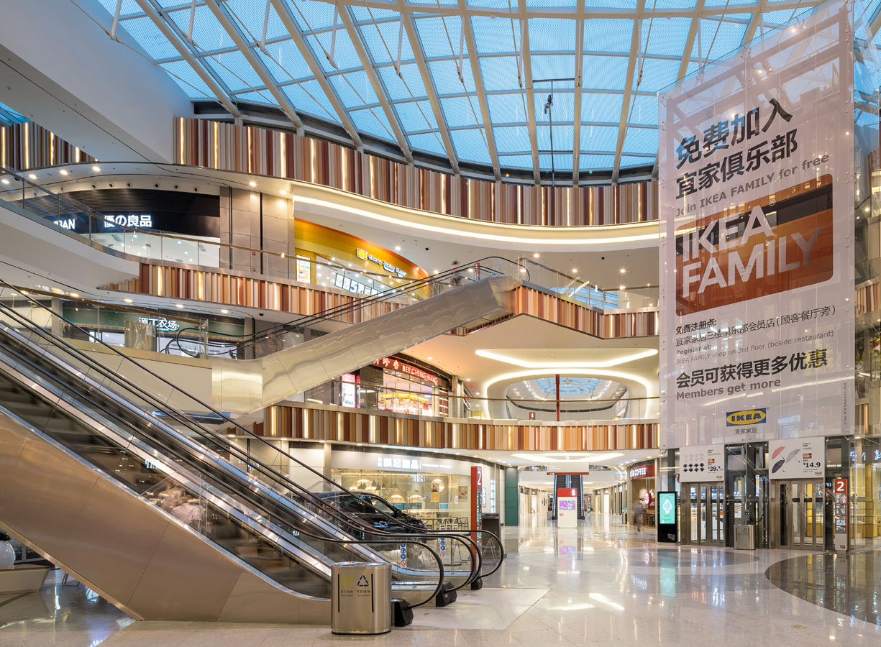
Pillar #4 ► Sectors of Economy ►Production ► Microeconomics
Types of Goods
Production Costs, EoS
Demand Laws, Elasticity
Supply Laws, Elasticity
Consumption, Utility
Market Types
Microeconomics => Micro-analysis….x; बाल की खाल मत खींचो; study to pass exam only

Slide 8

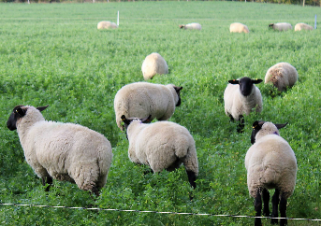

Types of Goods: No (directly) pay, no exclude
Criteria
Free/Paid
Exclude
Rivalry in Consumption
Opportunity Cost?
Free Goods Air
Free
No
No
No
Common Goods Fish, Grazing land
Free
No
Yes
No
Public Goods Street light, Defense
Free
No
No
Yes
Microeconomics => Micro-analysis….x; बाल की खाल मत खींचो; study to pass exam only

Slide 9

Tragedy of Commons (rivalry in consumption)
More sheep: Less grass left for next shepherd (Negative externality)
Too many sheep: Grassland can’t replenish.
Policy Solution: Tax on grazing rights, ceiling on usage

Slide 10
Type of Goods: Not (directly) paid then Exclude
Private good / Economic good
Merit good (bicycle), Demerit (Desi Liquor)
[Giffen, Inferior], Normal, [Luxury, Veblen]
Club Good / Artificially scarce good
Excludable, but no rival in consumption.
DTH, Kindle Ebooks, iTunes, Netflix, Google playstore paid apps
Rivalry in consumption ...yes
Depending on elasticity /responce to price-income
Microeconomics => Micro-analysis….x; बाल की खाल मत खींचो; study to pass exam only
Notes:
Even Local fire Department- If it lets your house burn.

Slide 11
CDS-2016/1
Which one of the following is not a “Public Good” ?
Light House
Public Parks
Electricity
National Defense
Hint: No directly pay, no exclude

Slide 12
UPSC’s CDS-II/2015
What is meant by ‘Public Good’?
A commodity produced by Govt.
A commodity whose benefits are indivisibly spread among the entire community
A Government scheme that benefits the poor households
Any Commodity that is very popular among general public

Slide 13
Pillar #4 ► Sectors of Economy ►Production ► Microeconomics
Types of Goods
Production Costs, EoS
Demand Laws, Elasticity
Supply Laws, Elasticity
Consumption, Utility
Market Types
Microeconomics => Micro-analysis….x; बाल की खाल मत खींचो; study to pass exam only

Slide 14
Types of Demand for Economic goods
Individual vs Market
Individual = household
Sum of All household demand = "MARKET Demand"
Ex Ante vs. Ex Post
Ex Ante = Wanted to buy (10 kg onion)
Ex Post = Actually bought (5 kg onion)-price, supply
Joint Demand =used together, bought together
Car-Petrol, Tea-Sugar, Bread-Butter
Car expensive= demand of petrol falls and vice versa.

Slide 15


Demand types: Derived demand
Derived Demand from building
Steel
Wood
Cement

Slide 16
Demand types: Derived demand
Demand for “factors of production“
Land
Labour
Capital

Slide 17
APFC/EPFO-2016
The demand for a “factor of production” is said to be derived demand because
It is a function of the profitability of an enterprise
It depends on the supply complementary factors
It stems from demand of final product
It arises out of means being scarce in relation to wants

Slide 18
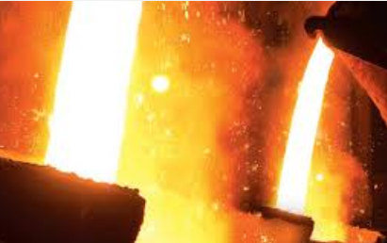
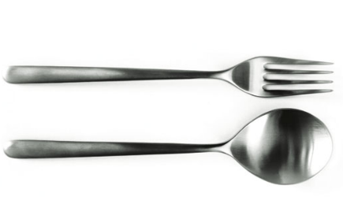
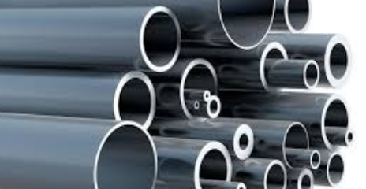

Demand types: Composite demand
Commodity with multiple alternative uses.

Slide 19

Demand elasticity: responsive of demand to price/income
Demand Elasticity (CPI)
Cross Elasticity
Income Elasticity
Price elasticity

Slide 20

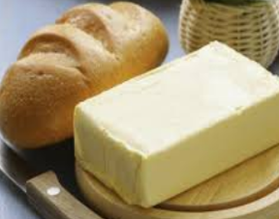
Demand: Cross elasticity
For given “Normal” item
But for another “normal” item
Price
Demand
Demand increase
+ve Cross elasticity
Demand decrease
-ve Cross elasticity

Slide 21
Cross Elasticity of demand (against price of some other product)
Substitutes: Positive Cross elasticity
Tea expensive => Coffee demand rise
Complimentary: Negative Cross elasticity
Cheaper Bread=> Butter demand rise
ZERO Cross elasticity
Cheaper tea => no impact on truck/car demand.
Cheaper Petrol=> car, bike demand rise
Similarly PC-Net, Mobile-connection, TV-set top box.
Microeconomics => Micro-analysis….x; बाल की खाल मत खींचो;
study to pass exam only
Notes:
1 lakh rupees = 273 years.

Slide 22

Demand elasticity: responsive of demand to price/income
Demand Elasticity (CPI)
Cross Elasticity
Income Elasticity
Price elasticity

Slide 23
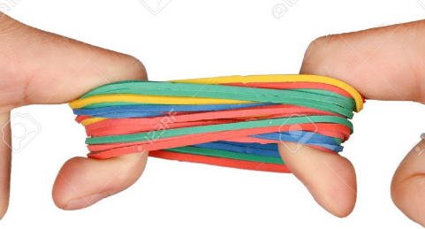
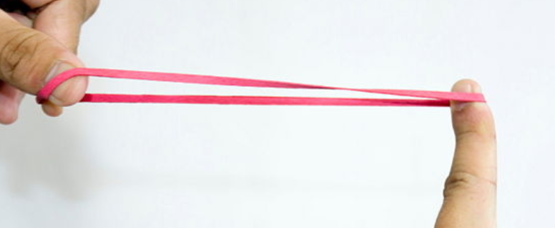
Demand: Price elasticity
For given “Normal” item
Inelastic
Elastic
Price
Demand

Slide 24

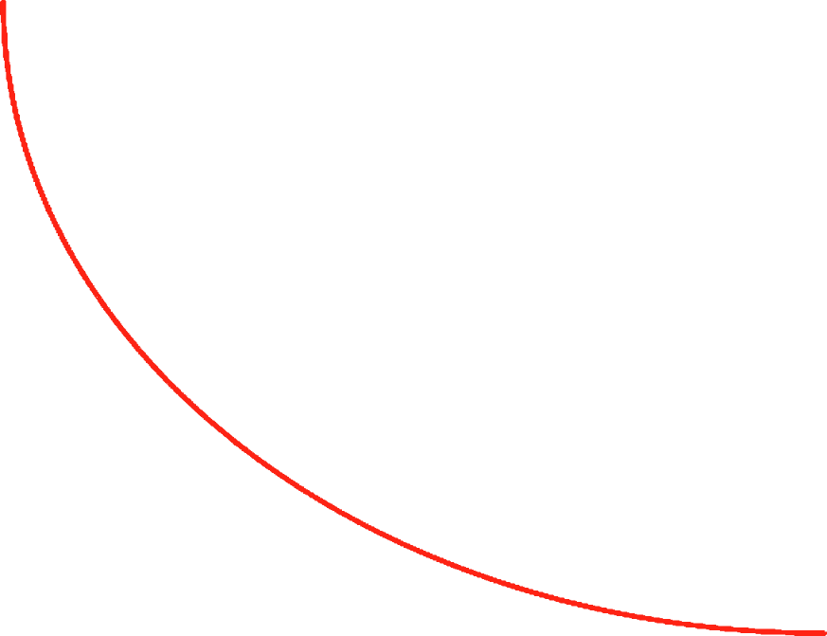

Price elasticity => Unitary elastic (e_{P}=1)
Price ▲ by 10% = demand ▼ by 10%
Price ▼ by 20% = demand ▲ by 20%
and so on……
Rectangular
Hyperbola
curve
PRICE
Quantity demanded

Slide 25
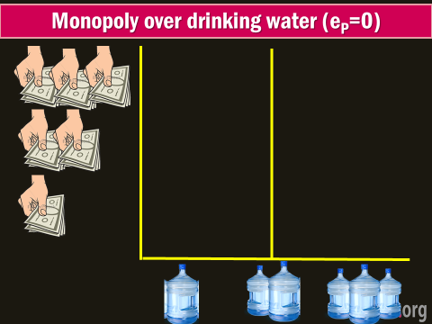
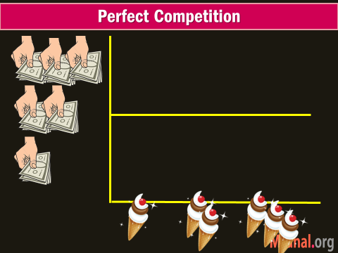
Price elasticity of Demand: (hypothetical)
Perfectly inelastic (0)
Perfectly elastic (∞)
Price doesn’t change demand
Water, food.
Willing to buy all they can at “x” price, but will buy zero quantity at slightly higher price
PRICE
Quantity demanded

Slide 26
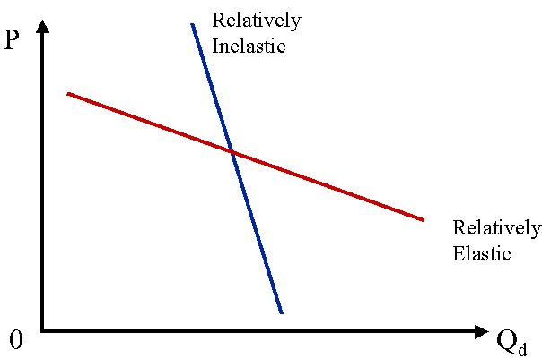
Price elasticity of Demand (Real)
(Relatively) inelastic (e_{P}<1)
(Relatively) elastic (e_{P}>1)
Price ▲ by 10% = demand ▼ by <10%
Price ▲ by 10% = demand ▼ by >10%
e.g. Milk since no close substitute; Tobacco=habitual, Monopoly-Rail
Happens if close substitutes available e.g. pepsi to coke; Pizzahut to Domino; MotoG to Micromax….
PRICE
Quantity demanded
Notes:
Negative slope

Slide 27
Demand’s “Price elasticity” will be more IF..
Luxury/comfort items: TV,AC, organic food,
If Time-period long => R&D => new substitutes
If postponement possible e.g. buying new jeans
If large no. of uses (e.g. Electricity for cooking => light)

Slide 28
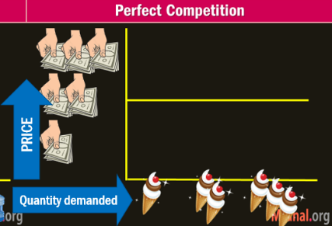
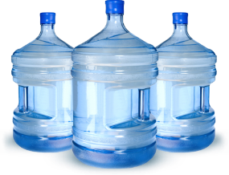
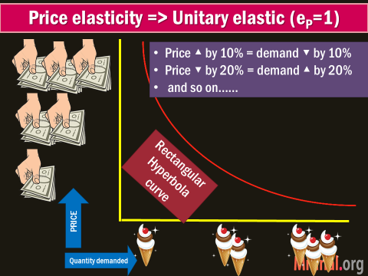
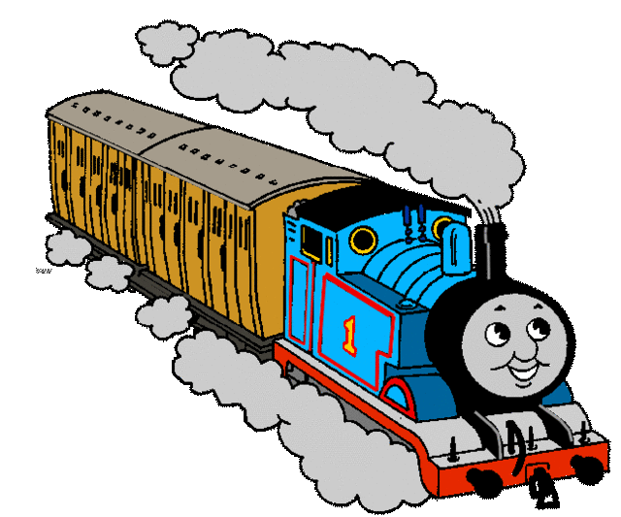



e_{P}: Price Elasticity of demand
0: Perfect Inelastic Water
∞: Perfect Elastic
1: Unitary
<1: Rel. Inelastic
>1: Rel. Elastic

Slide 29
UPSC’s APFC/EPFO-2016
Which of the following modes of transportation has highest elasticity ?
Air
Rail
Road
Water
Hint: Elimination- are alternatives ‘modes’ available if price increased?

Slide 30
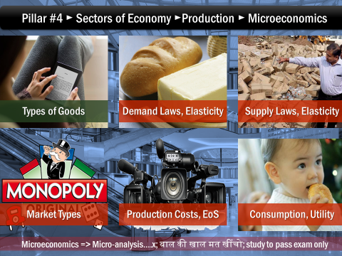
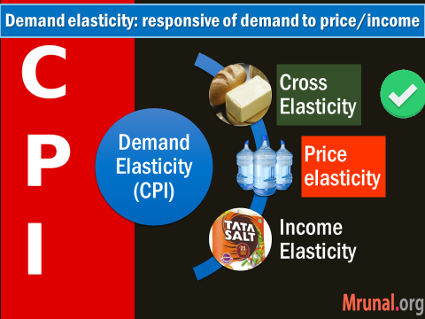
Exceptional cases
Giffen
Veblen

Slide 31

When is demand curve “positive slope”
Can there be goods with Positive slope?
Normal goods: Negative slope
PRICE
Quantity demanded

Slide 32

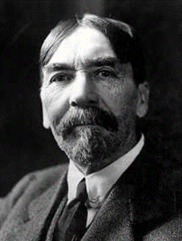
Demand curve shows positive slop when….
Status Symbol, conspicuous consumption.
Diamond, iPhone, paintings, Change in fashion
Curfew / Emergency /Speculation
Expecting that price will rise even more.
Higher price = higher prestige = more demand.
Snob Appeal/Veblen goods (Thorstein Veblen-USA)
thinking expensive item=better quality (iphone5 vs 5s)
Notes:
Demand Curve shifts to right when demand increase. Left when decline.

Slide 33
Giffen Goods

Slide 34



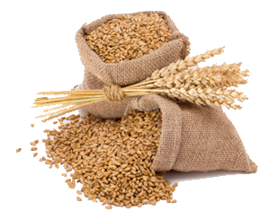

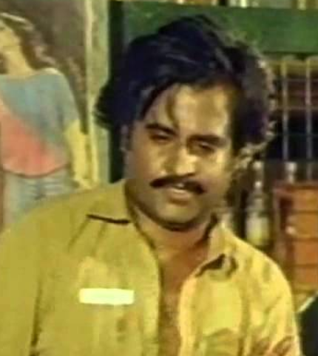
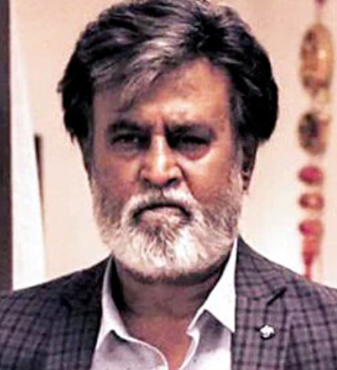
Price effect = (income + substitution) effect
Total utility is same = indifference to combos, but budget line permits not all combination
Substitution
Substitution
Income Effect

Slide 35
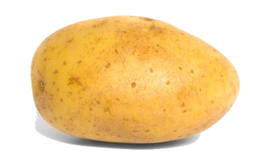



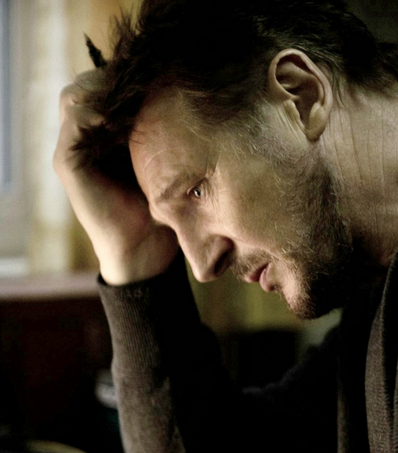

Giffen goods: inferior good without substitution
Substitution
Substitution
Income Effect

Slide 36



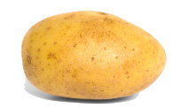

Giffen goods: inferior good without substitution
Price rise
Price rise
income effect dominates
Price fall
Price fall

Slide 37




When is demand curve “positive slope”
Giffen goods
PRICE
Quantity demanded

Slide 38
UPSC’s CDS-2015-I
What is the slope of exceptional demand curve?
Downwards to right
Upwards to right
Horizontal
Upwards to left
Hint: Veblen, Giffin, Curfew

Slide 39
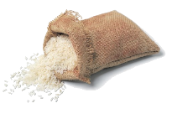
if too much price rise/ if substitutes were available
Backward slope
PRICE
Quantity demanded

Slide 40
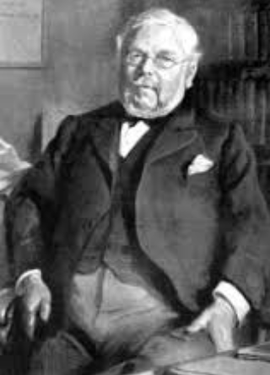
Sir Robert Giffen
Private Economy goods
Inferior goods
But, without substitution
Hence “income effect” is stronger
Exist in theory, not in reality. (Maize, Bajra)
But, Some evidence
Irish Potato famine 19th Cent.
case study: Poor Chinese families vs rice

Slide 41
Pillar #4 ► Sectors of Economy ►Production ► Microeconomics
Exceptional cases
Giffen
Veblen
Inferior Goods
Normal Goods

Slide 42
Slope of income vs. Normal Goods’ demand
Income rise, more quantity demanded
Positive slope
INCOME
Quantity demanded

Slide 43
Demand: Income elasticity
For given “Normal” item
Inelastic
Elastic
Income Salary
Demand

Slide 44
Income elasticity is positive for normal goods
Normal goods: Elastic
Normal Goods: Unitary Elastic
Normal Goods
10% salary rise=> 10% demand rise
10% salary rise => More than 10% demand rise (luxury, comfort goods)
Inelastic: <10% (daily necessities like soap, toothpaste)
Notes:
Salary instead of income – to easy understand.

Slide 45
Price effect = (income + substitution) effect
Total utility is same = indifference to combos, but budget line permits not all combination
Substitution
Substitution
Income Effect

Slide 46




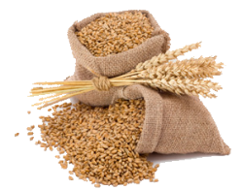

Income vs. inferior Goods (substitution possible)
Income rise, Less quantity demanded
Negative slope
INCOME
Quantity demanded
Notes:
Graph will stop here.

Slide 47
Income elasticity
Inferior Goods: Negative Income elasticity
10% salary rise=>fall in demand. E.g. Maize, Bajra, Kerosene; because shift to rice, wheat & LPG
ZERO income elasticity
Inexpensive essential items: salt, matchbox

Slide 48
UPSC’s CDS 2013-II
Income elasticity of demand for inferior good is
Less than one
Less than zero
Equal to one
Great than one

Slide 49



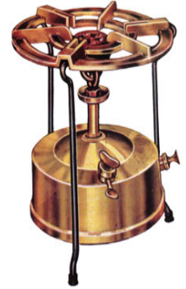
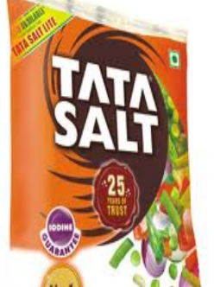

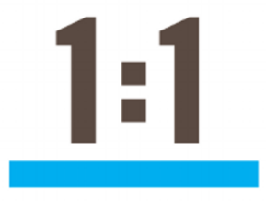
Income elasticity
NEGATIVE
ZERO
Unitary
>1
Aka Less than zero for CDS-2013

Slide 50
UPSC’s CDS-2016/1
Kerosene is inferior good in India, what are its implications?
As household gets richer, it consumes less kerosene
Over the time, kerosene quality declines
Government needs to stop Kerosene subsidy
Answer choice: 1&2, 2&3….

Slide 51
Demand elasticity: responsive of demand to price/income
Demand Elasticity (CPI)
Cross Elasticity
Income Elasticity
Price elasticity

Slide 52
Pillar #4 ► Sectors of Economy ►Production ► Microeconomics
Types of Goods
Production Costs, EoS
Demand Law, Elasticity
Supply law, Elasticity
Consumption, Utility
Market Types
Microeconomics => Micro-analysis….x; बाल की खाल मत खींचो; study to pass exam only

Slide 53
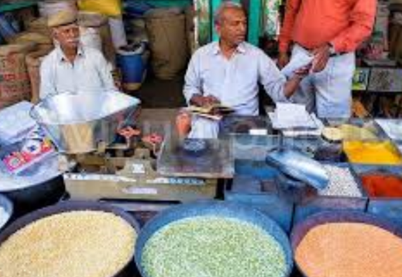

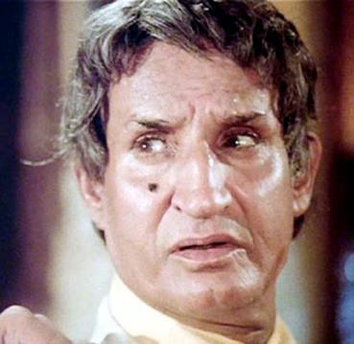
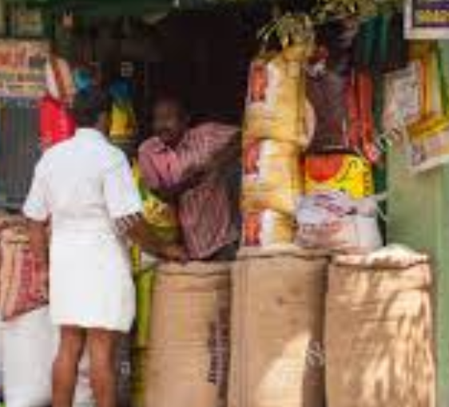
Stock is always ≧ Supply
Amount he’s willing to sell
Actual amount available
Stock
kg/date
Sum of individual firms’ supply =Market Supply
/per month
Notes:
Hoarding alone is not reason for less supply- he may not have space.
Supply function
Taxation. Subsidies
Price of related commodities
Agreement among producers
Transport- Communication
…

Slide 54
Supply Curve
Certeris Paribus (other things remaining same)
Positive slope
PRICE Offered
Long run- becomes flatter, as more firms, R&D come
Quantity Supplied

Slide 55
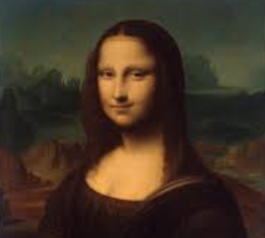
Elasticity of Supply against “Price offered”
For given “Normal” item
Inelastic
Elastic
Price offered
Supply

Slide 56
Supply elasticity: responsiveness to price “offered”
Perfect Inelastic
Mona Lisa Painting
Price change can never change supply
Perfect elastic
At “x” price- willing to supply infinite quantity
At any price less than “x”- stop supply.
Unitary
1% price offered = 1% supply rise
Relatively inelastic
Relatively elastic

Slide 57
Supply elasticity: responsiveness to price-change
(Relatively) Inelastic
(Relatively) Elastic
10% price rise: <10 % supply rise
10%▲ price offered: >10% supply rise
Long run: new plants, R&D
Perishable e.g. Milk, tomatoes
Durable, non-perishable Goods (unload stock)
Nature of input, expansion facilities (electricity)
Risk taking high- e.g. pulses.

Slide 58
Supply curve shifts
Extension
Leftward or inward shift = supply decrease @same price
Home work
Demand curve shift
PRICE Offered
Contraction
Quantity Supplied

Slide 59

Supply curve: when it’s Verticle
Rare artifacts, philately, numismatics
Once crop is planted
PRICE Offered
Quantity Supplied

Slide 60


Supply curve: when it’s backward sloping
1, 300
To spend more time on Leisure
2, 400
1, 100
Hourly WAGE
Labour Supply (total hrs worked)

Slide 61
Pillar #4 ► Sectors of Economy ►Production ► Microeconomics
Types of Goods
Production Costs, EoS
Demand Law, Elasticity
Supply law, Elasticity
Consumption, Utility
Market Types
Microeconomics => Micro-analysis….x; बाल की खाल मत खींचो; study to pass exam only

Slide 62

Market structure
Perfect competition
Monopoly
Monopolistic
Oligopoly
Monospony
Market: where buyer and seller strike a deal. Don’t need geographical location.
Notes:
Market structure- ability to influence price

Slide 63
Perfect competition
Participants
Buyers High | Sellers High
Product
Homogenous, many substitutes
rice, wheat
Knowledge/entry/exit
Perfect.
Seller is
PRICE TAKER not Price MAKER
Marketing/selling cost: NONE

Slide 64
Perfect competition & price elasticity of demand
Perfectly Elastic demand
Buyer willing to buy all they can- for “x” price, but will buy “ZERO” at even slightly higher price.
Buyer is price maker
PRICE
Quantity demanded

Slide 65
Monopoly GREEK word
Participants
Buyers many | Sellers 1 (RAILWAY, Electricity)
Product
Close substitute/ competition…..x
Knowledge/entry/exit
imbalanced by patent, laws etc.
Seller is
PRICE MAKER not Price TAKER
Price discrimination yes- between rich/poor; passenger vs freight
Marketing/selling cost….NONE
Microeconomics => Micro-analysis….x; बाल की खाल मत खींचो; study to pass exam only

Slide 66
UPSC’s CDS-II/2015
What is meant by price discrimination?
Increase in price of a commodity over time
A situation where the same product is sold to different consumers for different prices
Subsidization of a product by the Government to sell it at a lower price
General decrease in price of a commodity over time

Slide 67
UPSC’s CDS-II/2015
Which one of the following is an example of a ‘natural monopoly’?
(a) Indian Airlines
(b) Delhi Jal Board
(c) Delhi Transport Corporation
(d) Steel Authority of India
Notes:
Natural = extremely high fixed costs of distribution e.g. gas, electricity, water

Slide 68

India against Monopoly
1969
MRTP Act
2002
CCI ACT
Monopolies, restrictive trade practices act
Chairman DK Sikri (IAS) + 6 members

Slide 69
Monopolistic Competition
Participants
Buyers many
Sellers many- each selling ‘differentiated’ version
Product
Toothpaste, biscuit, jeans –brand loyalty till a price
Knowledge/entry/exit
Mostly free / unrestricted (esp. for Coaching thuggery)
Seller is
PRICE MAKER not Price TAKER (to a level)
Marketing /selling cost….HIGH
Monopoly over brand, but competition with Substitutes

Slide 70

Perfect competition & price elasticity of demand
PERFECT
inelastic (0)
If not understood, then watch part-I of video again.
PERFECT
Elastic (∞)
Elasticity declines
Monopolistic
Monopoly
PRICE
Quantity demanded
Notes:
Monopoly: Less elastic; -ve slope
Price increase 10%; demand -<10%

Slide 71
Oligopoly
Participants
Buyers many| Sellers : a few, with intense competition
Product
Close substitute…..yes
Knowledge/entry/exit
TOUGH- by economies of scale, patenting, tie-in with suppliers and distributors
Seller is
PRICE MAKER not Price TAKER
Interdependence…yes (if Maruti giving free insurance, Honda will have to)
Price cutting, price wars, marketing cost, selling cost…yes
Cartelization =when they restrict output to control price

Slide 72
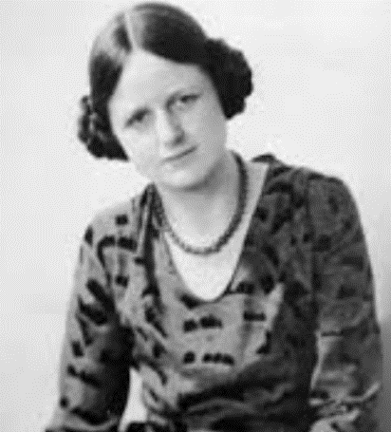
Monospony- By Dr. Joan Robinson
Participants
Buyers 1 (Govt of India for Defense, Railway)
Sellers : many
Product
Homogenous for a particular purpose e.g. railway seats; not railway-car-bike seats.
Knowledge/entry/exit
Lack of mobility- of labor/entrepreneur e.g. if coach factories started making cars then no monopsony.
BUYER is
PRICE MAKER not Price TAKER
Entry closed for other buyers (Defense, Railways, Atomic Energy)
Notes:
She was teacher of both mohan and Amartya in Cambridge univ.

Slide 73
Market structure
Perfect competition
Monopoly
Monopolistic
Oligopoly
Monospony
Market: where buyer and seller strike a deal. Don’t need geographical location.
Notes:
Market structure- ability to influence price

Slide 74
UPSC’s CDS-2014-II
Market with large number of sellers but each selling somewhat differentiated but close product, is termed as
Perfect competition
Monopoly
Oligopoly
Monopolistic competition

Slide 75
Pillar #4 ► Sectors of Economy ►Production ► Microeconomics
Types of Goods
Production Costs, EoS
Demand Law, Elasticity
Supply law, Elasticity
Consumption, Utility
Market Types
Microeconomics => Micro-analysis….x; बाल की खाल मत खींचो; study to pass exam only

Slide 76
What is Economic cost?
Real Cost: effort, sacrifices, physical-mental pain during production
Normal profit in
Perfect competition, Monopolistic competi.
Super normal /(abnormal) profit in
Monopoly, Monospony, Oligopoly
Hire, Purchase
Aka Money cost
Aka Accounting cost
Own land, own capital
Economic Cost
Explicit Cost
Implicit Cost
Normal Profit
Opportunity Cost
Notes:
1 car = 8 scooters
Factor price = if 7th PC = 18,000; then min. wages 18k?

Slide 77
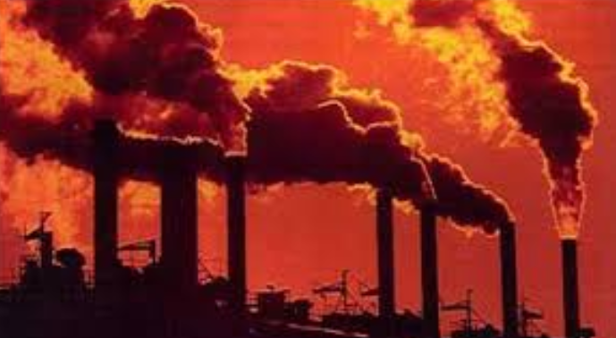
What is Social cost?
Thermal plant:
Air pollution, Respiratory diseases
Textile Mill:
Affluent, clean water
Social
Cost
Economic Cost
Private Cost
External Cost
Explicit Cost
Implicit Cost
Normal Profit
Opportunity Cost

Slide 78
Total Cost Curve
Fixed Cost
Variable Cost
Total Cost
Aka
Supplementary cost, Overhead cost, unavoidable cost
Aka
Prime cost, direct cost, avoidable cost
Property tax, Rent
Permanent employees
Interest on loan
License fee
Depreciation
Raw material
Excise duty
Casual workers
electricity
Microeconomics => Micro-analysis….x; बाल की खाल मत खींचो; study to pass exam only

Slide 79
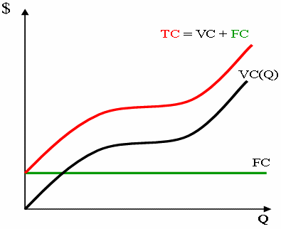
Total Cost curve
Parallel lines
Fixed cost- straight line

Slide 80
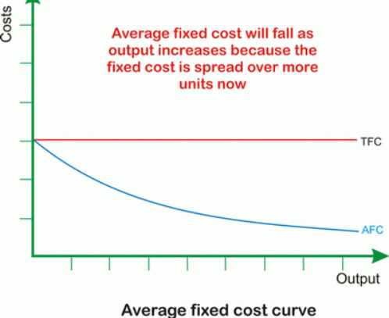
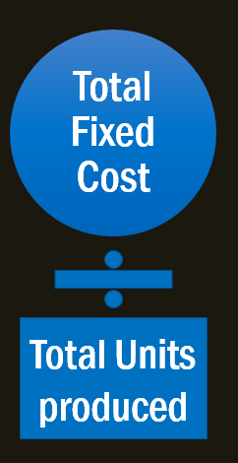

Average fixed cost?
Rectangular hyperbola

Slide 81
CDS 2013-II
Average fixed cost curve will always be
Rectangular hyperbola
Downward sloping convex to origin
Downward sloping straight line
U-shaped curve

Slide 82
Average Cost Curve
Total Fixed Cost
Total Variable Cost
Avg. Cost
Total Units produced
Total Units produced

Slide 83
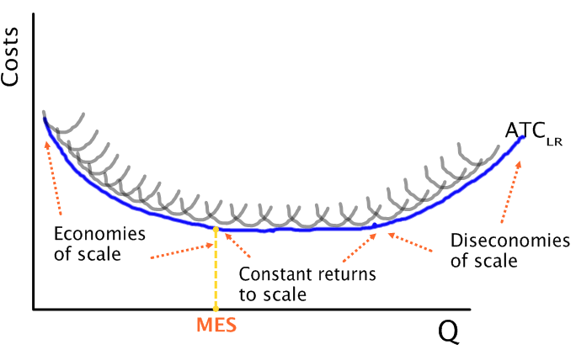
Long run Average cost (LAC) curve = U shape
Internal Economics of Scale
Technical, specialization, R&D, by-products used, marketing streamline , managerial efficiency by division of work
External Economics of Scale
Ancillary industry, cheaper input, skilled labour, localization- agglomeration..
Optimum production points
Notes:
. Localization economies occur when an increase in the size of an industry in a city leads to an increase in productivity of a particular activity.
Long run marginal cost curve is also u shaped.

Slide 84
Diseconomies of scale: why?
Send products far and far away= costlier transport.
Opportunity cost
Entrepreneur looses direct contact with labour- morale, motivation down
Coordination becomes difficult

Slide 85
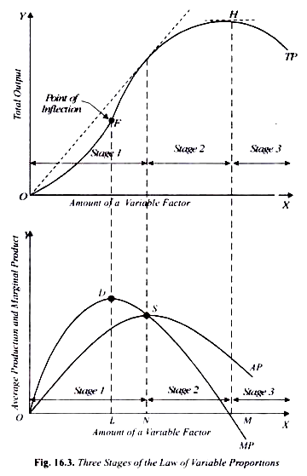
Law of variable proportion
Stage-I: increasing return
State-II: diminishing return
State-III: negative return

Slide 86
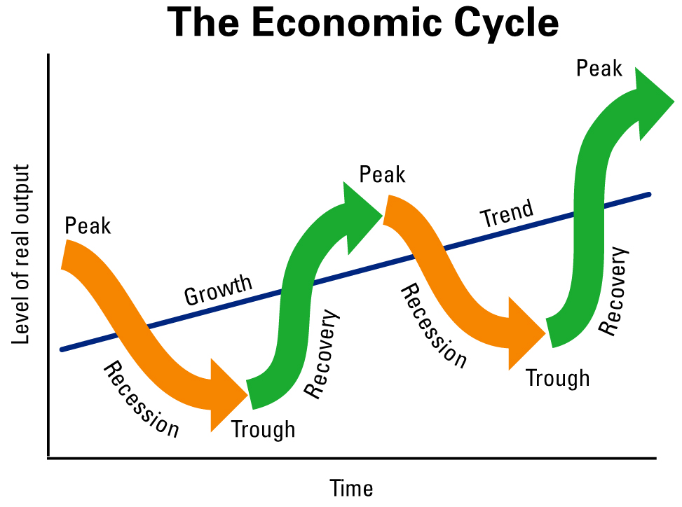
Double dip recession if too quickly…
e.g. 1 or 2 quarters of positive growth
REAL (inflation adjusted) GDP declines in 2 quarters continuously
Notes:
Expansion / prosperity
Recession
Depression
Recovery/Revival

Slide 87
Pillar #4 ► Sectors of Economy ►Production ► Microeconomics
Types of Goods
Production Costs, EoS
Demand Law, Elasticity
Supply law, Elasticity
Consumption, Utility
Market Types
Microeconomics => Micro-analysis….x; बाल की खाल मत खींचो; study to pass exam only

Slide 88
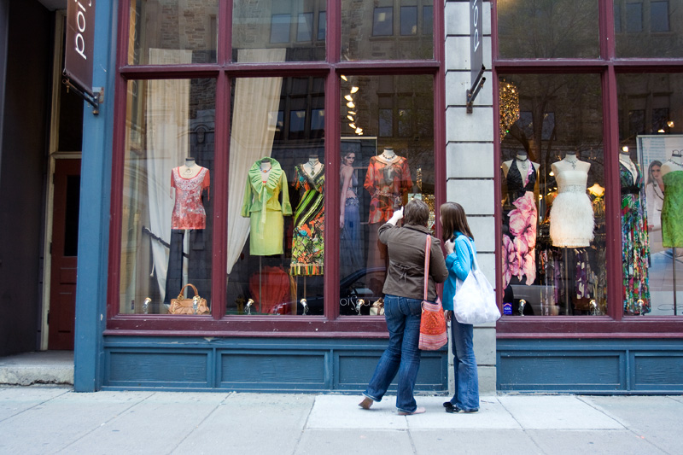
Micro-economics BASIC TERMS
WANT / Desire
Consumption
Aggregate Demand, Std. Of Living…..
Utility
"Want" satisfying power of goods/services
Primary (Basic)- Food shelter, Clothing
Secondary: comfort, luxury
Using goods/services To Satisfy WANTS
Marginal Utility…price equilibrium
Production
Making goods/ services that have "utility"
4 Factors of Production
DEMAND: Willingness to buy @certain price @certain time
Notes:
Factor Market e.g. Capital Market => Primary vs Secondary

Slide 89
UPSC’s CDS-2015-I
Demand of a particular commodity refers to
Desire
Need
Quantity demanded
Quantity demanded at certain price during a particular period of time.

Slide 90


UTILITY
Concepts
Utility: “satisfaction” from consuming one unit
Relative: Roti for hungry vs non-hungry
Subjective, abstract, can’t see, touch
Detached from morality, usefulness (DESI LIQUOR)
Marginal Utility: Additional “satisfaction” from consuming one more unit. -> usually diminishing/decreasing

Slide 91
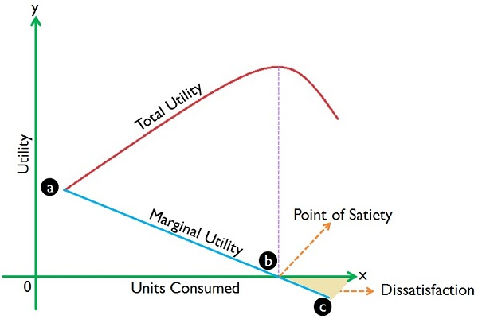
Total utility =Sum of marginal utilities
Concave from above
Satiation point
TU=max
MU=ZERO
Beyond that
TU=decline
MU=negative
-ve slope
German Economist H.H.Gossen 1st formulated
But proper statement British Economist Alfresh Marshall

Slide 92
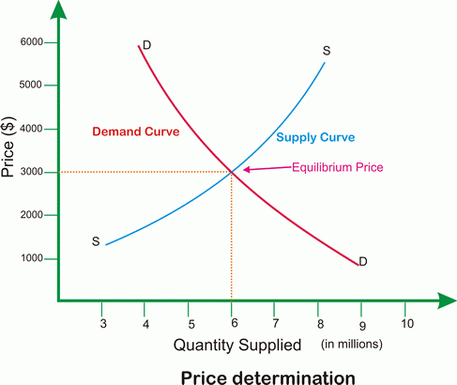


Equilibrium Price
Marginal Utility = Max. price I’m willing to pay.
Excess Supply
Marginal cost of production
= min. price I expect
Excess Demand

Slide 93
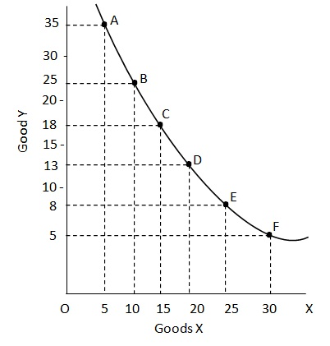
Indifference= combo that gives same satisfaction
If shown as Table= Indifference “SCHEDULE”
If shown as graph= Indifference Curve” /iso-utility curve.
Food unit | Cloth Units | Marginal rate of subst.
4 | 4 | 1:1
2 | 6 | 1:3
Will give him same “TOTAL” satisfaction

Slide 94
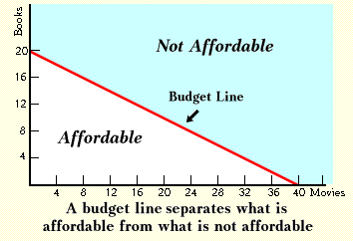
Budget line- all combos not possible?
Food | Cloth | MRS
4 | 4 | 1:1
2 | 6 | 1:3
All combos give same satisfaction, but
For a given budget which combos are possible?
negative slope

Slide 95
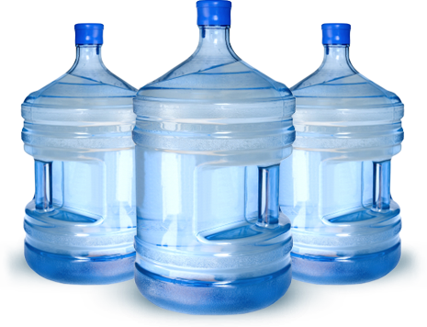
Value- household places on a commodity
High value “in use”
Low value “in exchange”
Less value “in-use”
High value “in exchange”
Why this “Value paradox”?
Ans. Scarcity
“Paradox of Plenty”
e.g. more crop=farmer earn less. Hence Govt. MSP
“Paradox of thrift”
As people become more thrifty- they save less or same (David Ricardo)
How to measure “Value” ans. Money
Evolution, pri-deri. Function etc. L3/P7
Notes:
Value on a commodity- placed by household.
Value in use: HIGH for Water (frequently used)
Value in exchange: HIGH for Diamond (rarely used, but scarce)
2 vs. 3 = Value paradox, answer “scarcity”
Measure of Value? Ans. Money. Evolution, Primary / derivative functions- SELF STUDY

Slide 96
GLOSSARY of terms
Class 12 micro and macro economics- glossary @end

Slide 97
Concepts
Consumption
Saving
Investment
Wealth

Slide 98
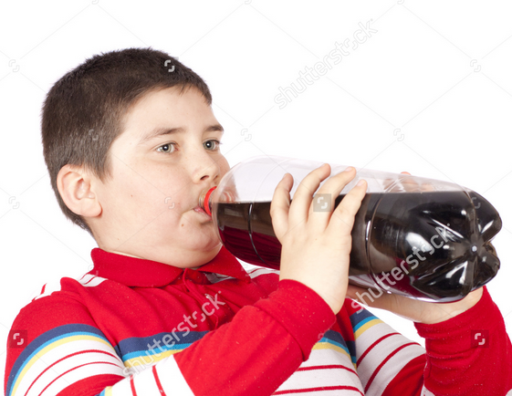
Factor Income: Rent, Wage, (interest, dividend), profit
Total Consumption
Avg. Propensity to consume
Total Income
Change in consum.
Marginal Propensity to consume
Change in income
Notes:
National Income: ++ of all FINAL goods and services by RESIDENTs

Slide 99


Slide 100

Aggregate Saving: Private + government
Total Saving
Avg. Propensity to Save
Total Income
Change in Saving
Marginal Propensity to save
Change in income
Notes:
Saving= income not spent on "consumption"

Slide 101



Income level vs. Savings and Consumption
Consumption increase with income
Consumption is never ZERO or -VE
Saving increase with income
@break even level, saving=0
@low income, savings can be negative

Slide 102

Savings has declined or stagnated
WHY? Ref: BES161/P7

Slide 103
Concepts
Consumption
Saving
Investment
Wealth

Slide 104

INVESTMENT OR CAPITAL Formation
Concept
"ACT" of adding capital goods- machines, tools, land, building etc.
Money spent buying new plant, factory, machines, tools; “Stock”
Private investment: Profit motive
Public Investment: welfare

Slide 105

Investment Multiplier (Richard Kahn 1905)
Investment (100)
Consumption
Income (330)
Railways: 3.3 (Survey)
Infra: 2.4 (RBI)
Notes:
It was said in survey 2014

Slide 106
Capital formation rate has declined…
WHY? Ref: BES161/P2 & P7 + “THINK”
Notes:
Twin balancesheet problem

Slide 107

Capital formation or investment
GROSS Investment MINUS Depreciation = NET INVESTMENT.
“Fixed” Investment or “FIXED” capital formation
= Value of new machine, equipment and construction
GDP @Expenditure side

Slide 108
Wealth = ASSETS that are source of income
National wealth
Reproducible assets
machine, building
Non reproducible
mineral, land, free gifts of nature
Domestic resident’s assets …no, because offset by liability
"NET foreign assets"....yes.
Microeconomics => Micro-analysis….x; बाल की खाल मत खींचो; study to pass exam only

Slide 109
Concepts
Consumption
Saving
Investment
Wealth

Slide 110


Production Possibility Curve

Slide 111



Production Possibility Curve?
Economy Problem
Resources limited
Wants unlimited
Concave from origin- Opportunity cost
What to produce? How much to produce?

Slide 112

Production Possibility curve
Economy Problem
How to produce? Labour or capital intensive?
For whom to produce? Subsidization / luxury tax?
Economic growth (Narrow) vs. Development (Broad-inequality, poverty)?

Slide 113
Match the following
Set A
Economist
Set B
Book
Idea

Slide 114
List not exhaustive
Alfred Marshall (1842), UK "Principles of Economics"
Social Science
Study wealth, study man
John Maynard Keynes (1883), UK “ Economic Consequences of the Peace”
Recession=> expansionary fiscal policy => aggregate demand
Versailles Treaty => another European war
Adam Smith (1723), Scotland “Wealth of Nations”
Science- wealth of nations
Laissez Faire, Free Market
Aristotal (384 BC), Greece
Science
Management of family and state

Slide 115
List not exhaustive
Lionel Robbins (1898), UK
Human science
Scare means, alternative use
Paul A. Samuelson 1915, USA, 1st American to Nobel
How people and society choose
Growth oriented
Milton Friedman- (1912), USA Nobel in '76
Neolibralism, Anti Keyenes, Reganism, Free market
Book: Freedom to Choose

Slide 116
Pillar #4 ► Sectors of Economy ►Production ► Microeconomics
Types of Goods
Production Costs, EoS
Demand Law, Elasticity
Supply law, Elasticity
Consumption, Utility
Market Types
Microeconomics => Micro-analysis….x; बाल की खाल मत खींचो; study to pass exam only

Slide 117
Theory +Economic Survey Vol.2 + Vol.1 + Budget 2016
1.Banking Finance
6.HRD
2.Budget-Fiscal Policy
3.BoP
4.Sectors of Economy
5.Infra
V2C2-Pub.Fin; V1C3-JAM
V2C3-Monetary mgmt+FI
V2C4-External sector
V2C5-Price,Agri.; V2C6,7
V2C8-Paris Summit, Energy
V2C9-Social infra.
V1C4-Agri ; V1C9-Fertilizer
V1C5-mother-child
V1C6-bounties; V1C7-Fiscal Cap
V1C8-PTA
V1C2-Chakravy; V1C10-Labour
V1C11-Powering 1 India
B1. Financial Sector Reforms
B2. Fiscal Discipline
B3. Tax Reforms; B4. Ease of
B5. Agro: 2x farmer income
B6. Rural infra-employment
B7. Infrastructure
B8. Social Sector & healthcare
B9. Education, Skills, Jobs
V2C1- Chakravyuh challenge
V1C1- Twin Balancesheet
IYB:7-Commerce
Agri
Mfg
MicroEcon
GDP Inflation

